Slide 1
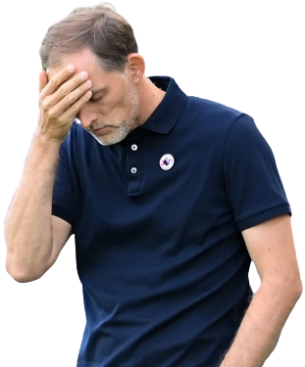
THE ART OF GETTING SACKED.
By:
Jahnvi Patel & Yusuf Ejaz

Slide 2
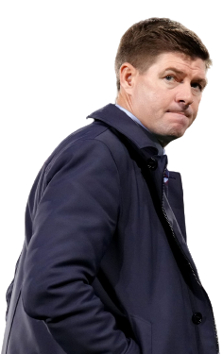


Research Question?
What are the factors that contribute to a football (soccer) manager being sacked?
Getting Sacked
Metrics

Slide 3

Methodology
Algorithms
5
1
3
Data Collection Process
Limitations or Assumptions of our approach
2
4
Data Cleaning Techniques
Statistical Methods

Slide 4
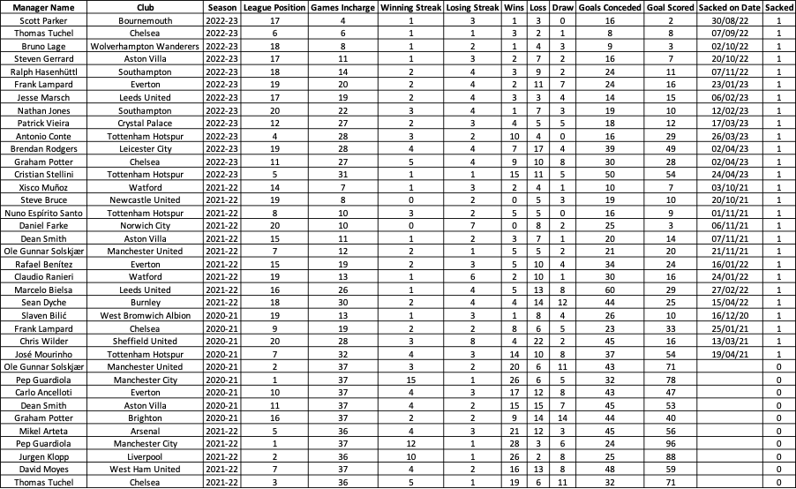
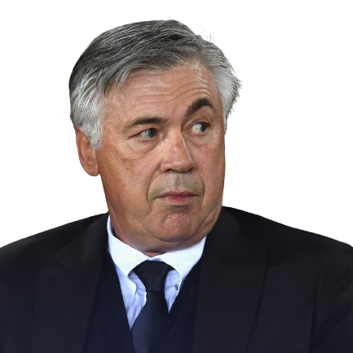
Data
Exploration

Slide 5
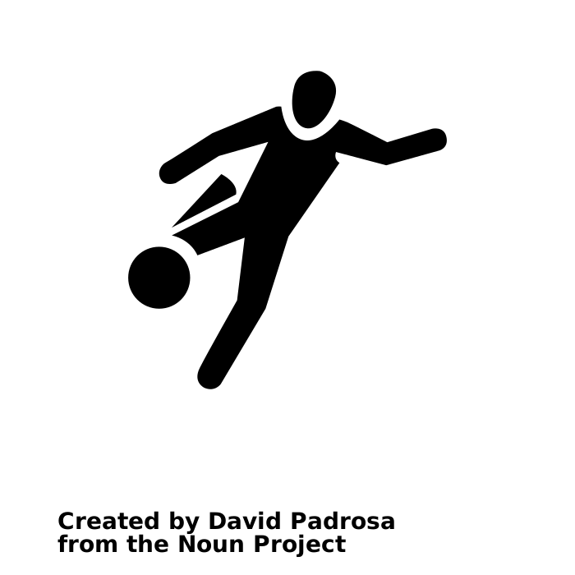


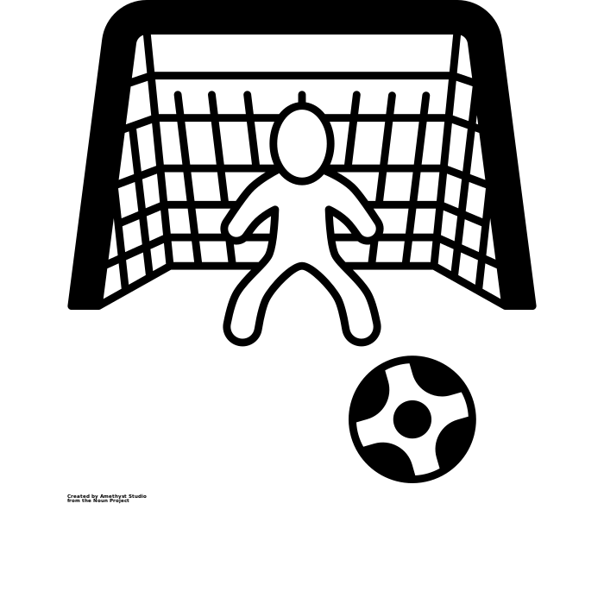

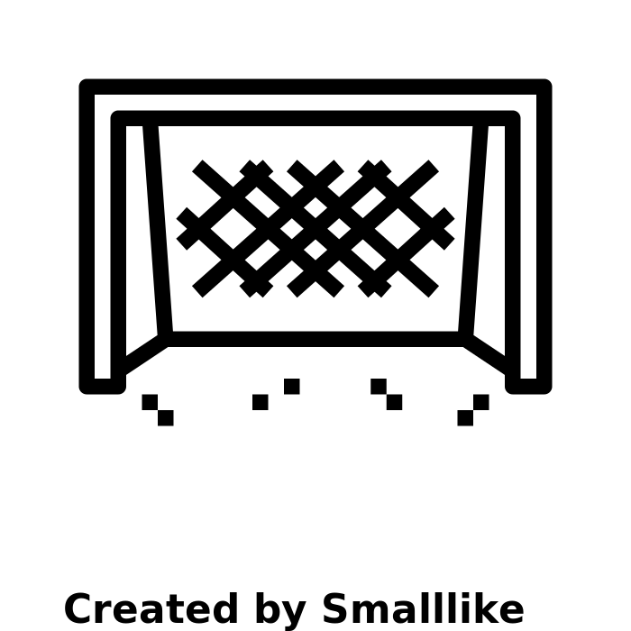


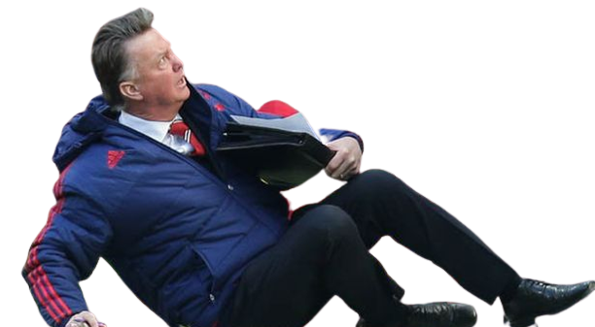

Feature Selection
Games Played
Number of matches played by the team.
Wins
Number of matches won by the team.
Draw
Number of matches ended in a draw.
Goals Against
Total goals conceded by the team.
Loss
Number of matches lost by the team.
Goals For
Total goals scored by the team.
League Position
The rank of the team in the league table.
Winning Streak
The number of consecutive wins.
Losing Streak
The number of consecutive losses.
Sacked
Whether or not the manager was sacked.

Slide 6


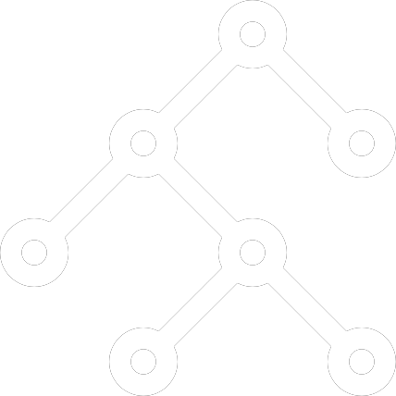

Model Exploration
Classification & Clustering
Decision Tree
Random Forest
Naive Bayes
K-NN

Slide 7
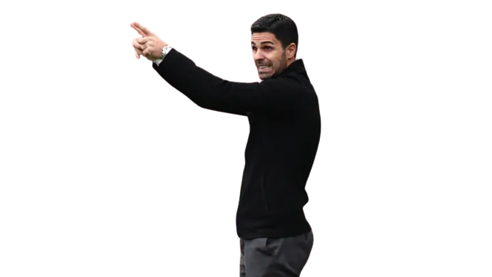
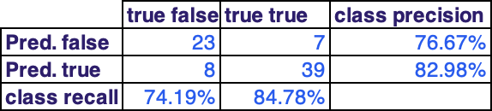
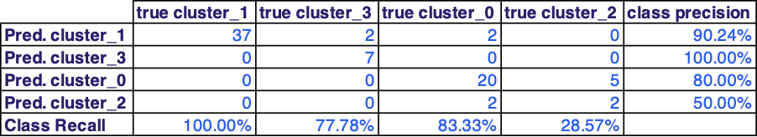
Model Evaluation
Decision
Tree

Slide 8
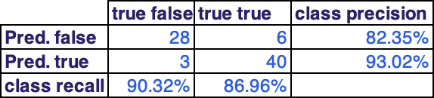

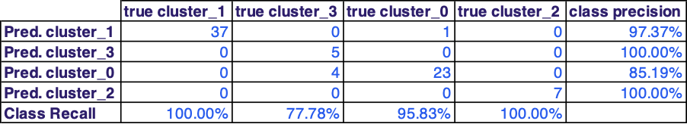
K-NN
Model Evaluation

Slide 9
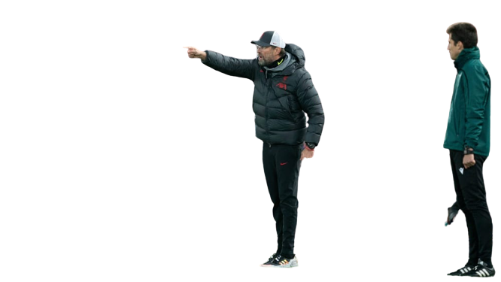
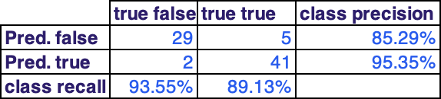
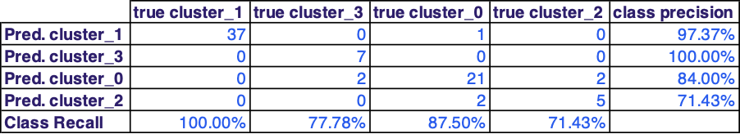
Model Evaluation
Random
Forest

Slide 10
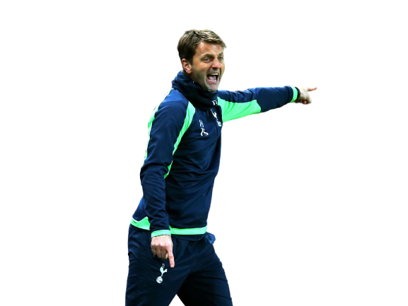
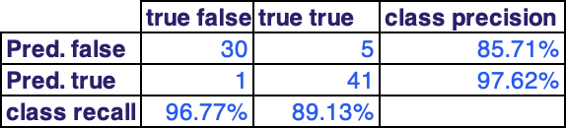
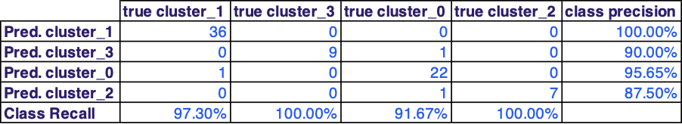
Naive Bayes
Model Evaluation

Slide 11
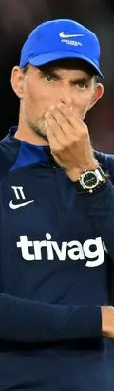
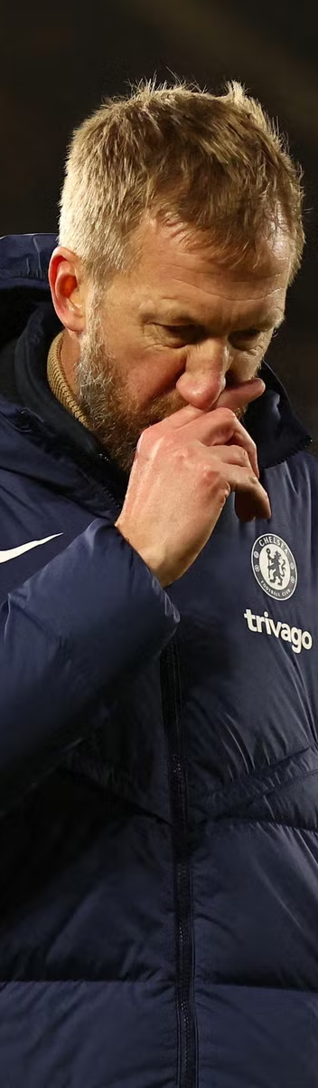
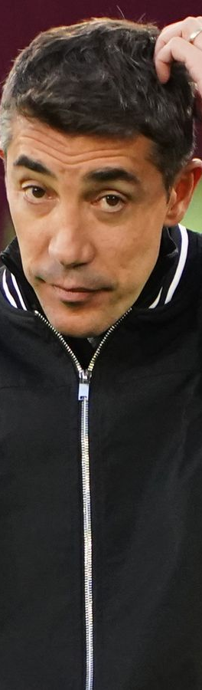

Discussion &
Conclusion
ACCURACY: 92.32%
Naive Bayes was found to be the most accurate model for classification. Note that clustering accuracy results are not relevant due to the small dataset with only 6 seasons included.
Thomas Tuchel
Graham Potter
Bruno Lage
Antonio Conte

Slide 12

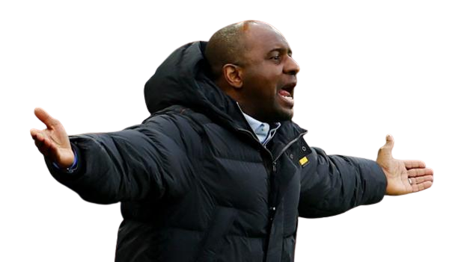
THANK YOU!
Any Questions?

